Slide 1
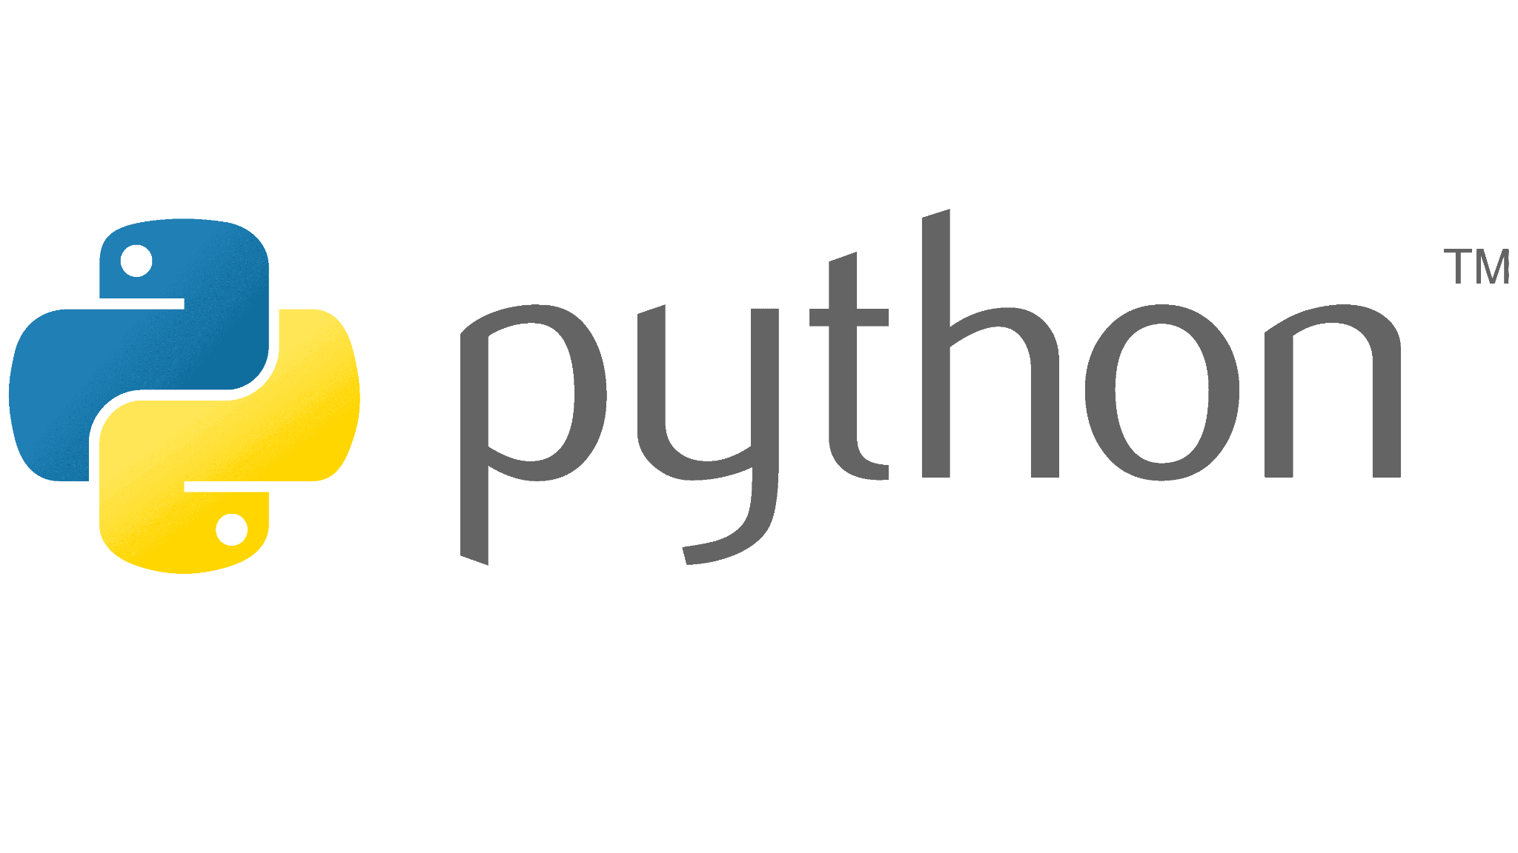


Slide 2

Last lecture reminder
We learned about:
What is computer programming and for what we need it
High level programming language and machine language
What is algorithm and what define a good algorithms
Introduced the programming flowchart and flowchart symbols
What is a variable
Different types of primitive variables

Slide 3

What is Python?
Python is one of the most popular programming languages in the world. It is widely used for various applications, including web development, data analysis, artificial intelligence, automation, and more. Python was first introduced in 1991 by Guido van Rossum, with the goal of creating a simple, easy-to-read programming language that could be used by both beginners and experienced developers.

Slide 4
What is Python?
By using Python, we can build:
Backend web applications using frameworks such as Django and Flask
Data analysis and visualization tools using libraries like Pandas, NumPy, and Matplotlib
Machine learning and artificial intelligence applications with TensorFlow, PyTorch, and Scikit-learn
Automation and scripting tasks for various purposes, like web scraping and system administration
Games using libraries like Pygame and Panda3D

Slide 5
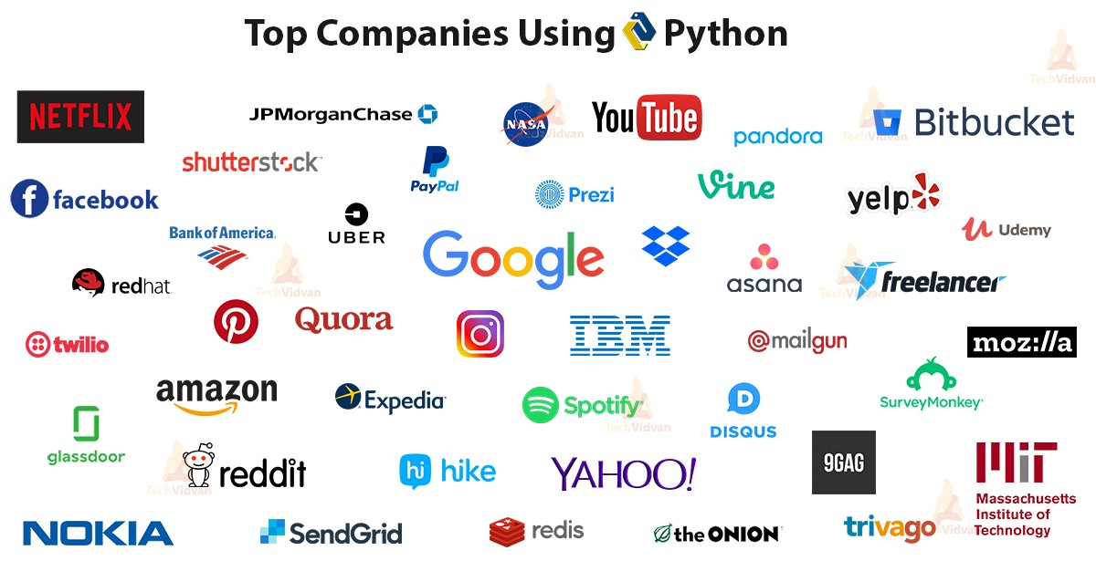

Slide 6

Client side vs Server side

Slide 7




Client Side
A Client can be every machine that its purpose is to make requests through the web and display the response
For example - :
A client can also be a program like web browsers or desktop applications that have a connection to the web (like word, excel, computer game, exc... )
Basically we can say that a client is a machine or a program the its purpose is to make requests through the web and display the response

Slide 8
Server Side
Server is a machine that run computer programs that it purpose is to handle the clients requests and provide the relevant response to each request
Servers contain all the logic that the program need in order to handle the client request and produce the response. In the industry this is called the “Business Logic”
Servers are also responsible for managing and saving the program data In the industry this process is been called “Persistency”
Because the servers are the machines that should handle all the requests from the clients (the “load”) they should be very strong and be high-performance computers
The more our site needs to support more people meaning our server will need to support more client requests, the more our server computer need to be strong and our programs need to be more efficient

Slide 9
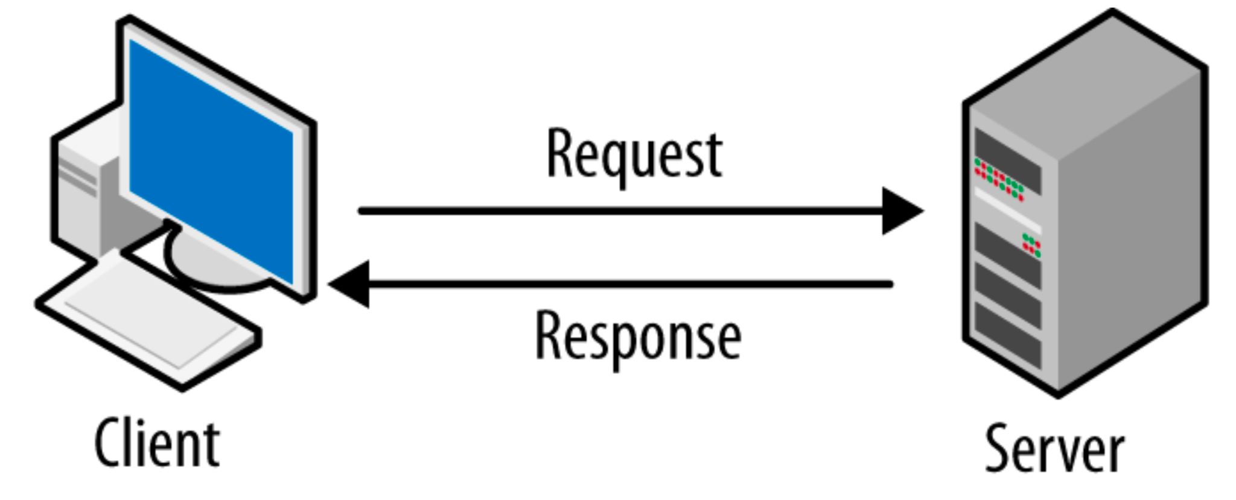
Client - Server model

Slide 10
Python Features
Interpreted programming language - interpreted language, which means that it executes the code line by line, without compilation process.
Dynamic typing - Python supports dynamic typing, which means the types of the variables being created are determined at runtime based on the stored value.
Platform independent - Python is not reliant on any platform to execute the code, which means that once you write your script, it can be run anywhere and anytime, provided the proper interpreter is installed.
Interpreted language - Mean that Python code is been processed line by line
Async processing - Python supports asynchronous processing using libraries like asyncio and async/await syntax. This allows sending requests and processing other tasks simultaneously without waiting for a response.

Slide 11
Python Features
Object-Oriented Programming (OOP) - Python supports object-oriented programming, allowing you to create classes, objects, and inheritance, which makes it easier to design and implement scalable and modular applications.
Multiple Inheritance - Python supports multiple inheritance, which means a class can inherit attributes and methods from more than one parent class.
Exception Handling - Python supports robust exception handling using try-except-else-finally blocks, which allows developers to catch and handle exceptions or errors gracefully at runtime.

Slide 12
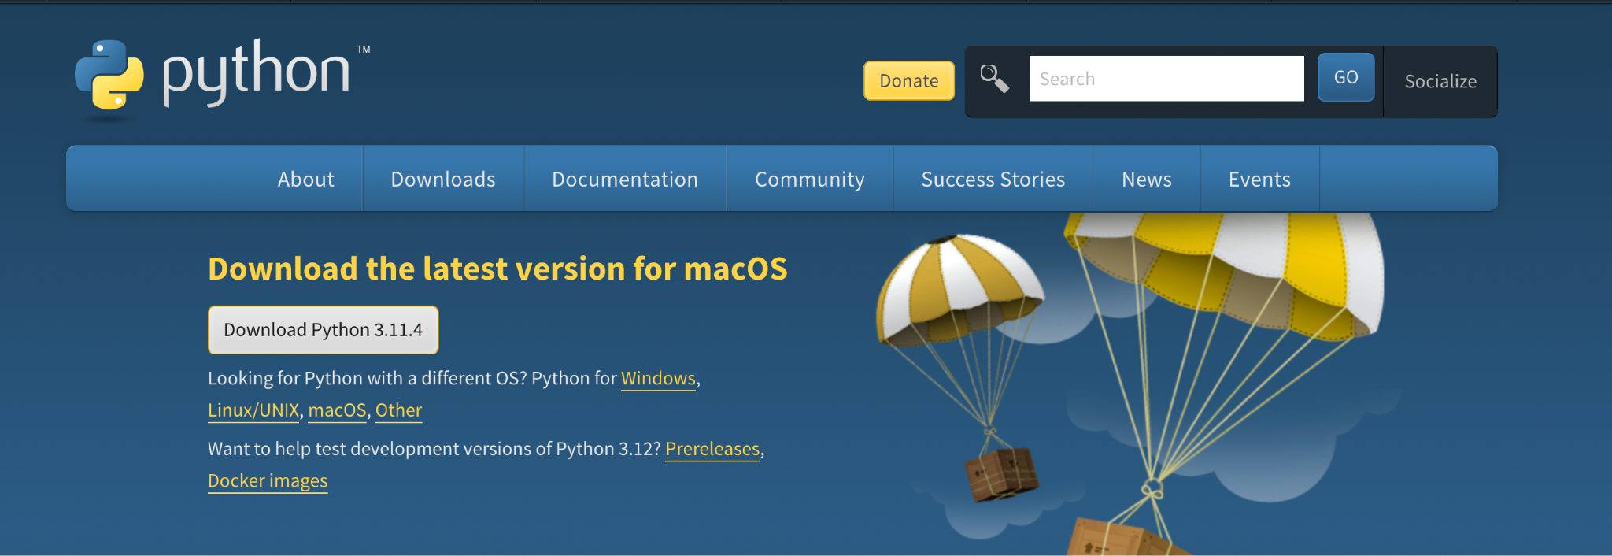
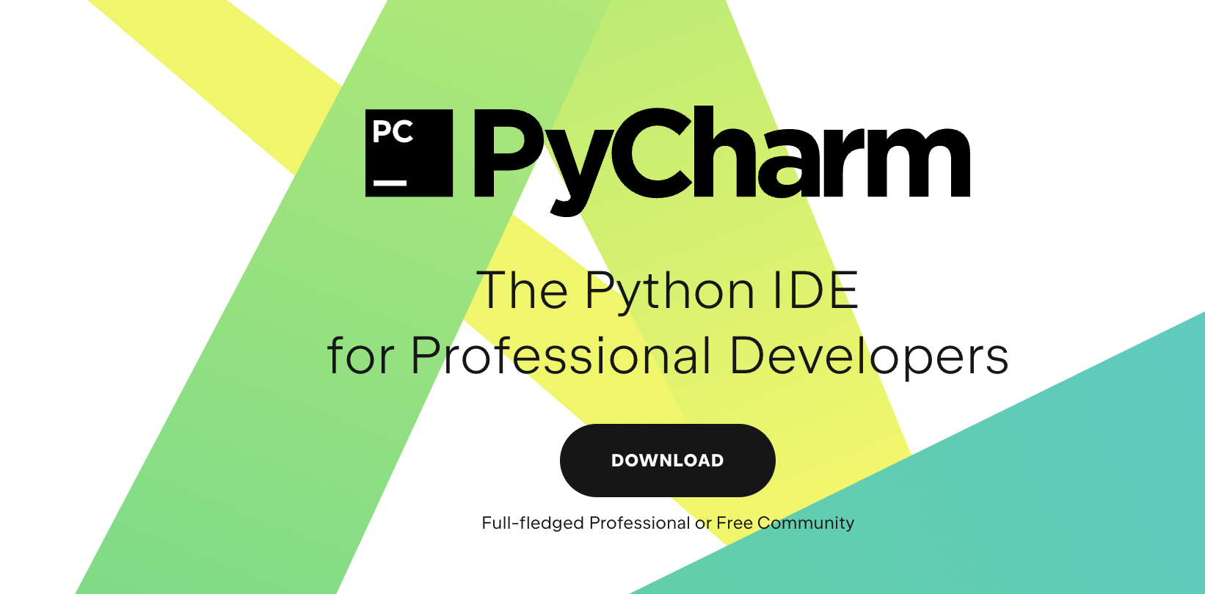
Python Setup
Install Python latest version from Python official website → https://www.python.org/downloads/
Install Python IDE - Pycharm Community Edition → https://www.jetbrains.com/pycharm/

Slide 13
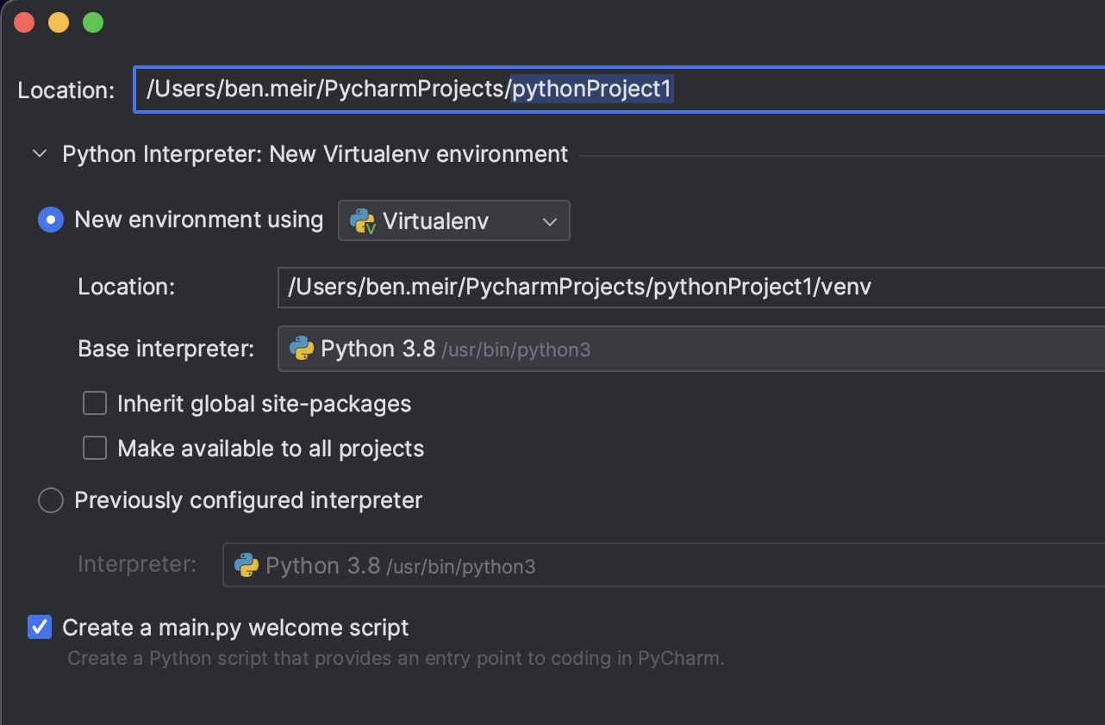
Python Setup
Once installed, open Pycharm IDE and select new project, make sure pycharm is recognizing your Python version in the Base interpreter section.

Slide 14
Python Setup
Once installed, open Pycharm IDE and select new project, make sure pycharm is recognizing your Python version in the Base interpreter section.

Slide 15
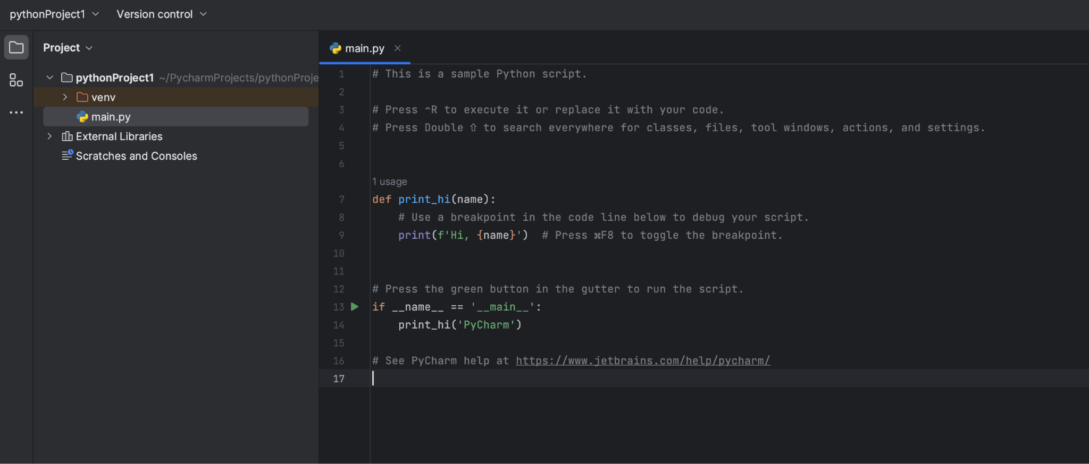
Python Setup
Once your new project was successfully created it should look like this:

Slide 16
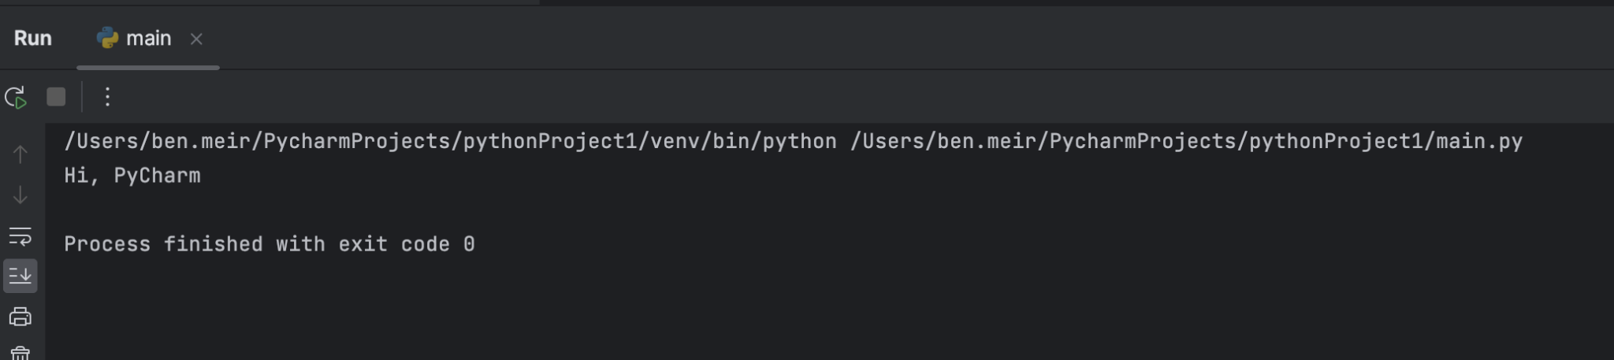
Python Setup
Press on the green play button and make sure your program is running, The output of the program should look like this:

Slide 17
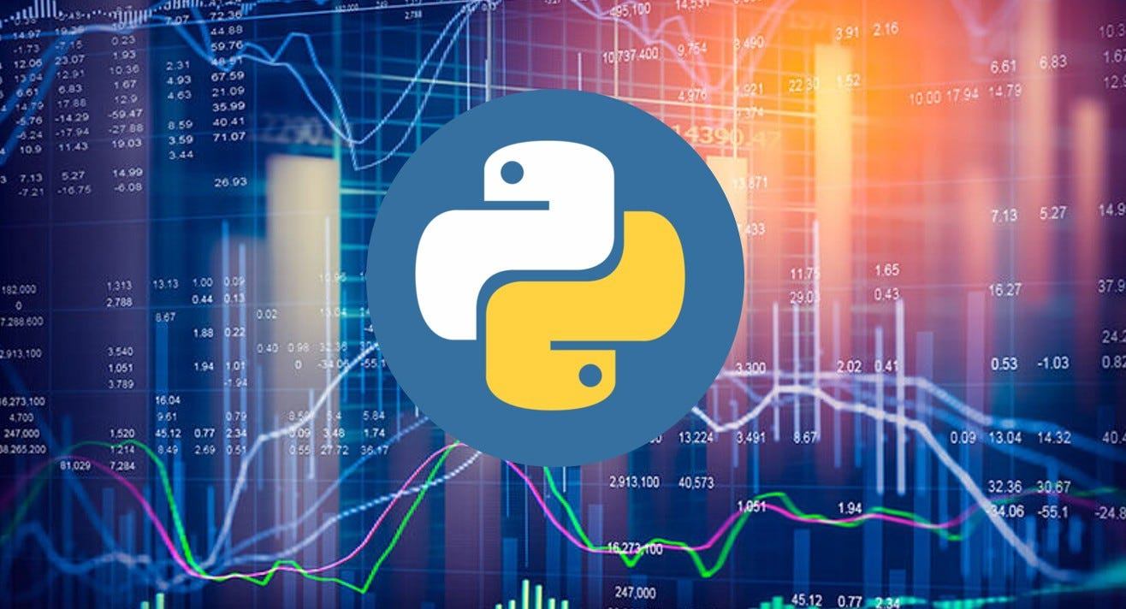
Let’s Learn How To Write Python

Slide 18
Variables in Python
As we learned in the last lecture, variables are very important notion in writing computer programmes Variables are functioning as containers that allow us to store data inside of them and use this Data everywhere we want inside our program Every variable has its own type and as we saw, it is important to choose the right variable type for the right purpose
Because Python support dynamic typing, when we creating a new variable we don’t need to determine the type of it - instead the type of the variable will be define in run time

Slide 19
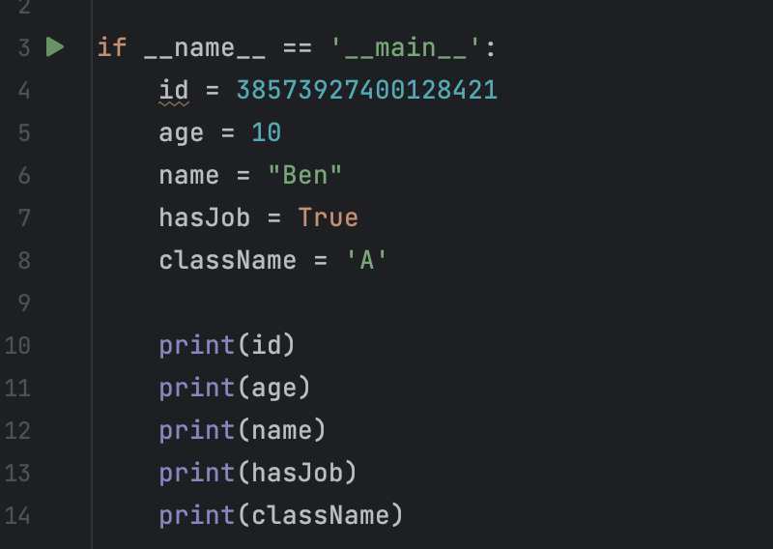
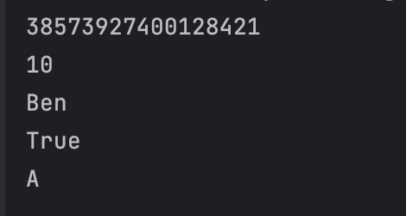
How To Create Variables In Python?
Variables in Python are very easy to create, we just need to write the name of the variable (declaring the variable) and the value we want to assign to this variable. As we saw, in every programing language we have some primitive variable types:

Slide 20
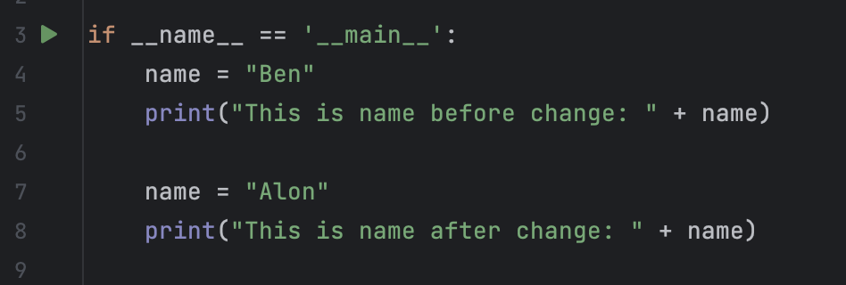
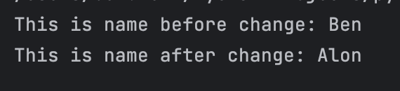
How To Create Variables In Python?
Once we declared on a variable we can’t create another variable with the same name but we can override the value assigned to that variable with a new value. For example:

Slide 21
Operators in Python
Operators are syntax symbols that allow us to perform specific actions on primitive data types and variables In Javascript we can find a lot of operators that each of them is relevant to different family The most used operator families are:
Arithmetic operators - addition, subtraction, multiplication, division exc...
Relational operators - used in logical statements to determine if a logic statement will return a “true” or “false”
Logical operators - used in logical statements to determine equality or difference between variables or values
Assignment operators - used to assign values to Javascript variables

Slide 22
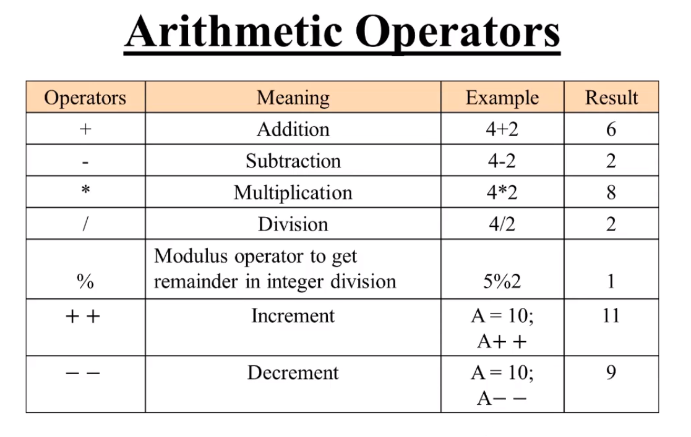

Slide 23
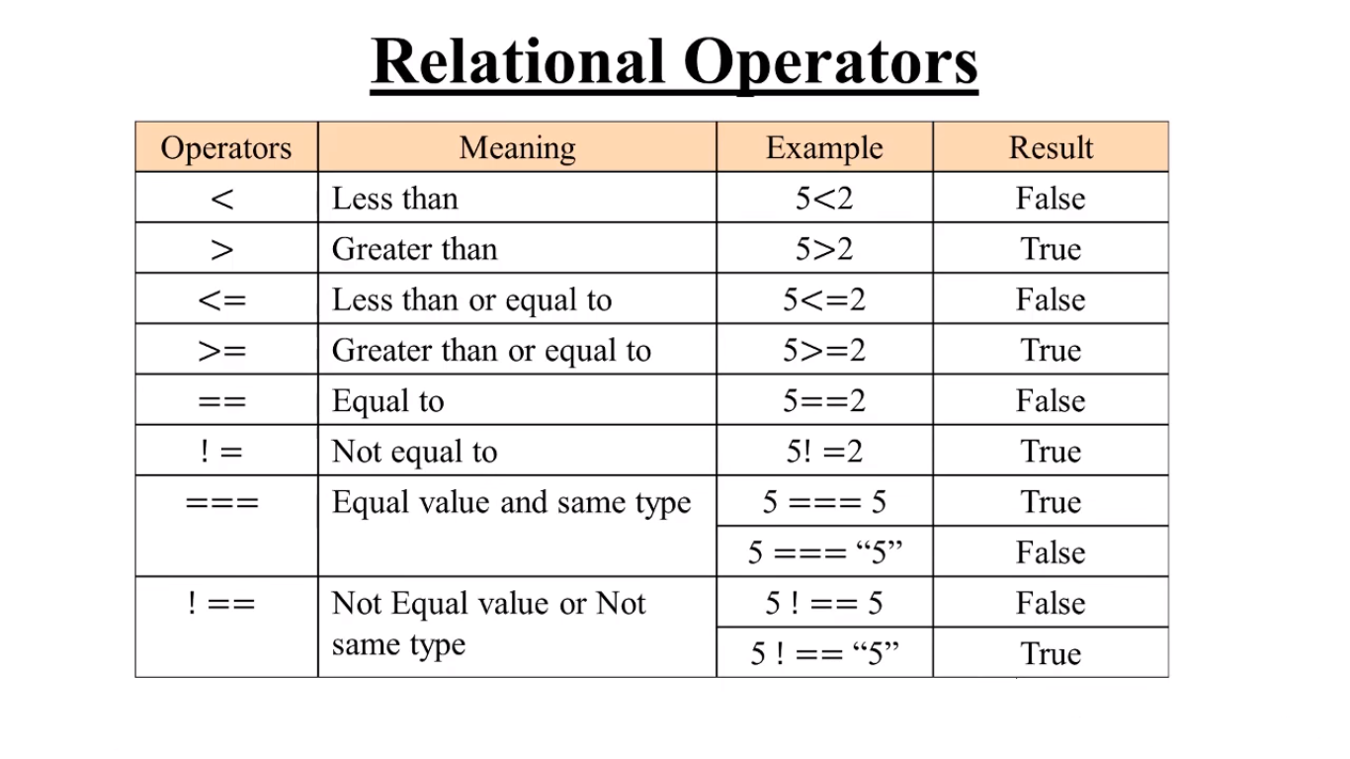

Slide 24
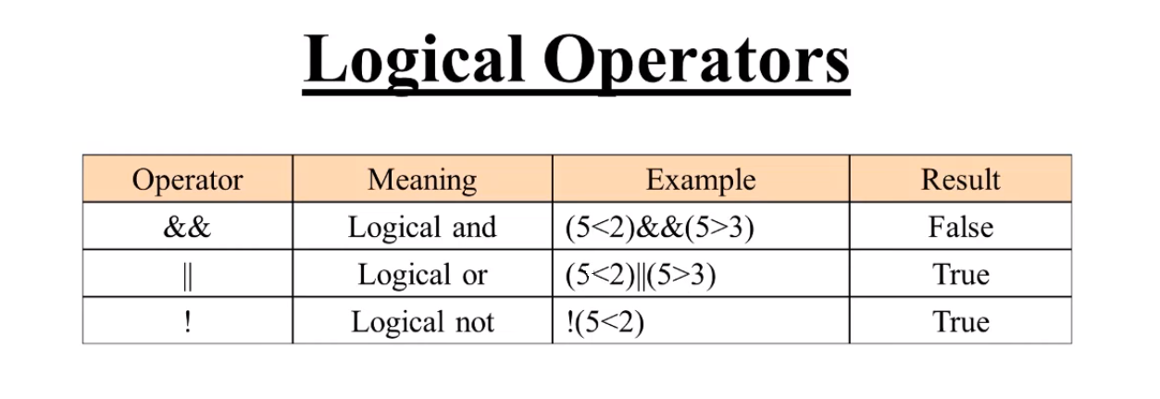

Slide 25
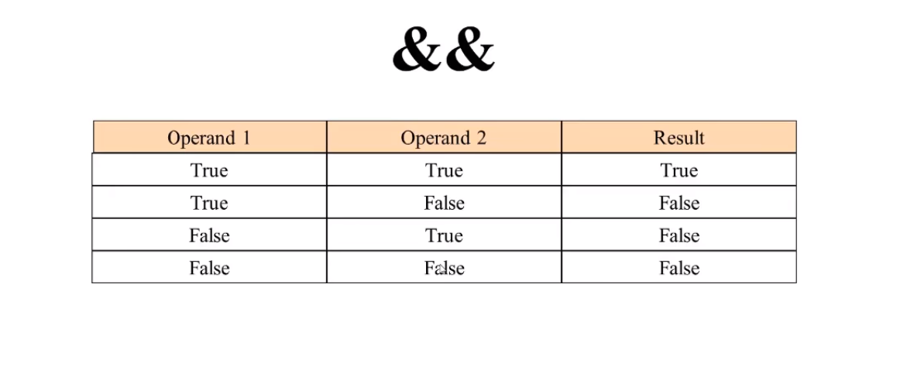

Slide 26
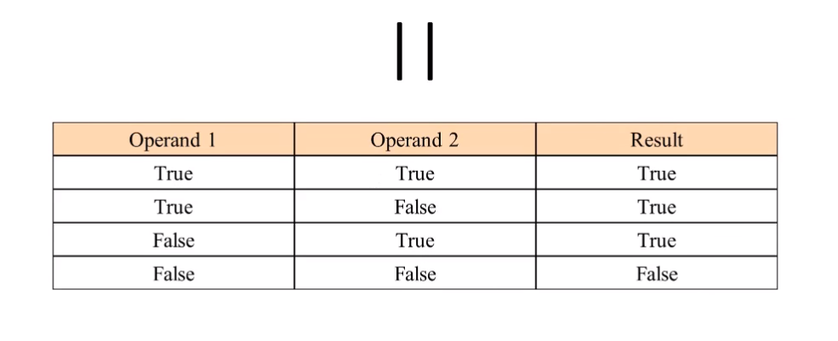

Slide 27
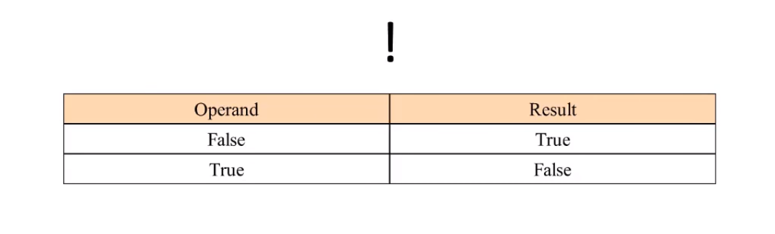

Slide 28
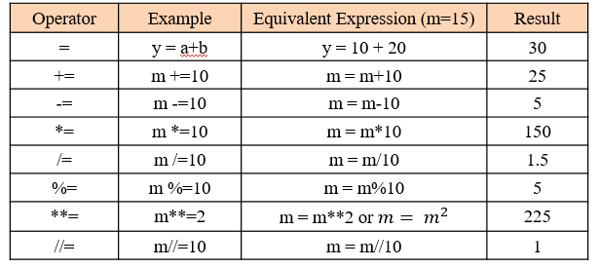
Assignment Operators

Slide 29
Class Exercise - Variables and Operators

Slide 30

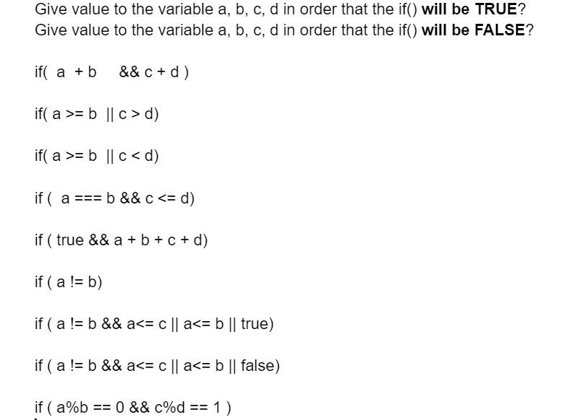
Class Exercise - Variables and Operators
Instructions:
Answer the following questions:

Slide 31
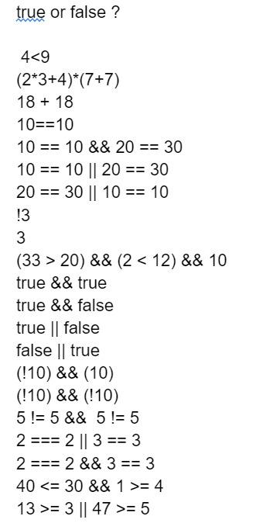
Class Exercise - Variables and Operators
Instructions:
Answer the following questions:

Slide 32
Class Exercise - Variables and Operators
Instructions:
Open the PyCharm IDE and go to existing project or create new project
Write a Python program that execute the following:
Create two variables and save and assigned two numbers to them
Print the result of every arithmetic operator we learned
Use print() function for print the result
Override every value from every variable you created with a new value (not necessary from the same type)
Print the result of the override action using the print() function

Slide 33
Class Exercise Solution - Variables and Operators

